Slide 1
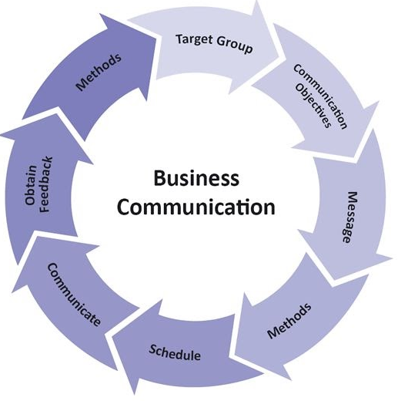
Business Communication

Slide 2

Review Areas
What is Business Communication
Methods of BC
Examples of BC in an Organization (small, medium, or large)
Types of BC
Internal vs External
Mediums of BC
Benefits of effective BC

Slide 3

What is Business Communication (BC)
Whether written, verbal, or nonverbal, it’s the instrument used by business to communicate & engage their employees & consumers.
Mechanism used by management to influences employees and guides their activities. It is also the means by which the employees provide information and feedback, which are necessary to the management to take smart decisions.
Organizations which carry out clear, meaningful and effective communication with clients, employees, share-holders, creditors and the public have better chances of building reliable relationships and can count on good cooperation.

Slide 4
BC Methods
Verbal
Language used to transfer information through speaking or sign language & active listening is a key part of verbal exchanges.
E.g. virtual meetings, phone calls & in-person conversations
Non-verbal
Use of gestures, facial expressions and other nonverbal cues to convey information to others.
E.g. Thumbs up, Head nod
Written
Delivering information through print or digital media.
E.g. emails, letters, memos, reports and other documentation.
Visual
use of images and graphics to convey information.
E.g. charts, maps, graphs, infographics & videos along with verbal or written communication to deliver powerful presentations & provide helpful context.

Slide 5

Examples of Business Communication
When employees communicate with one another
When management and employees communicate
When employees and customers interact
When a company releases a new product
When a business launches a marketing or advertising campaign

Slide 6
Benefits of Effective Business Communication
Increased productivity
Increased sales and better return on investment (ROI)
Less workplace conflict
A more positive and inclusive company culture
Improved employee engagement
Better brand reputation
Reduced employee turnover
More productive training

Slide 7
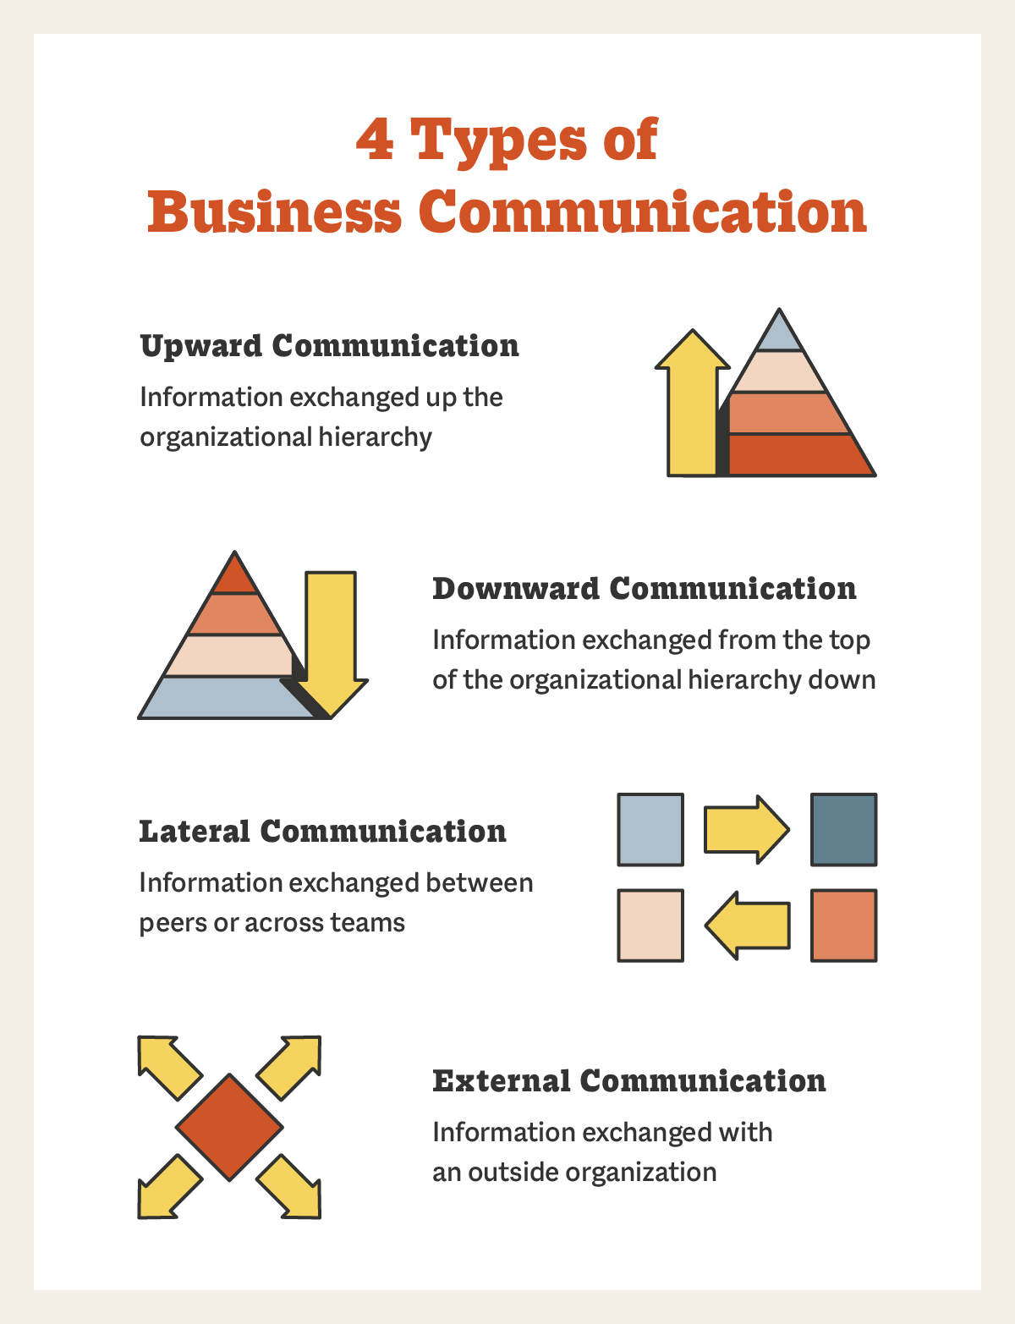
Types
Upward Communication
Downward Communication
Lateral Communication
External Communication

Slide 8
Internal Communication
Upward Communication/Bottom-up Approach
Downward Communication/ Top-Down Approach
Lateral/Peer Communication

Slide 9
Downward Communication/ Top-Down Approach
Upward Communication/ Bottom-up Approach
Decisions made at the highest level require to be efficiently shared throughout the organization
As a result, many firms adopt top-to-bottom communication to guarantee that information flows freely from senior management to different level personnel.
Anything that is sent from a subordinate to a manager or someone higher up the organizational hierarchy is considered to be this form of business communication
Lateral/ Peer Communication
Communication among coworkers in the workplace is referred to as lateral communication. This could be interdepartmental communication or even departmental business

Slide 10
External Communication
Any communication that deals with clients, potential clients, vendors, or partners is considered external communication
Communication with vendors outside the Company organisational structure

Slide 11
Internal
Phone calls
External
Phone calls
Emails
Website/ Social Media
Advertising - brochures/Pamphlets/Flyers
Meetings - Face-to-Face & Video Conferencing
Letters
Memoranda
Emails
Letters
Meetings - Face-to-Face & Video conferencing
Forms
Intranet
Forms

Slide 12

Memoranda
Memorandum (singular) Memoranda (Plural)
Memoranda are brief, informal reports used to establish a record.
They generalize the communication process by transmitting the message from one or more authors to one or more recipients.
The memorandum is among the most versatile of organizational documents.
From brief reports to trip itineraries & introductions to proposals.
Used to communicate technical & administrative information.
Memoranda are written for numerous internal purposes:
request information,
make announcements,
outline policies,
transmit meeting minutes.
Memos are crucial to establishing a record of decisions, requests, responsibilities, results, and concerns.

Slide 13

Formal Memorandum Template
To: [Audience] From: [Person and/or Department issuing the memo] Date: [Date Sent] Subject: [Subject of the Memo]
[Opening – Get to the point in the opening paragraph. Keep things simple and short. Make it easy and fast to read.]
[Summary – Provide enough background so all readers understand the history, but again, keep it simple.]
[Conclusion – End with a call to action.]
CC: [Send copies to anyone affected by the memo.] Attachments: [List any attachments to the memo. Only list items referred to in the body of the memo.]

Slide 14
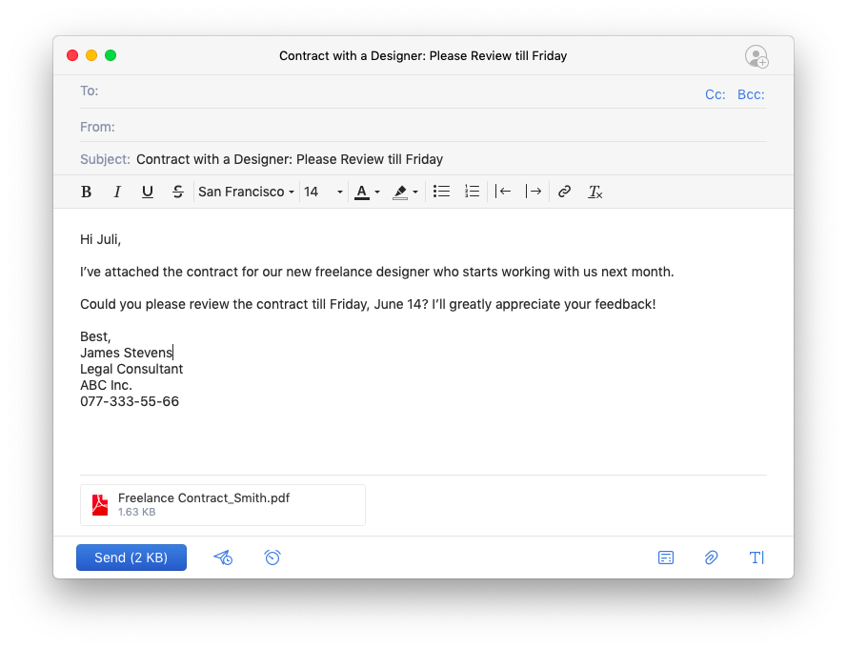
Are emails a type of Memo?

Slide 15
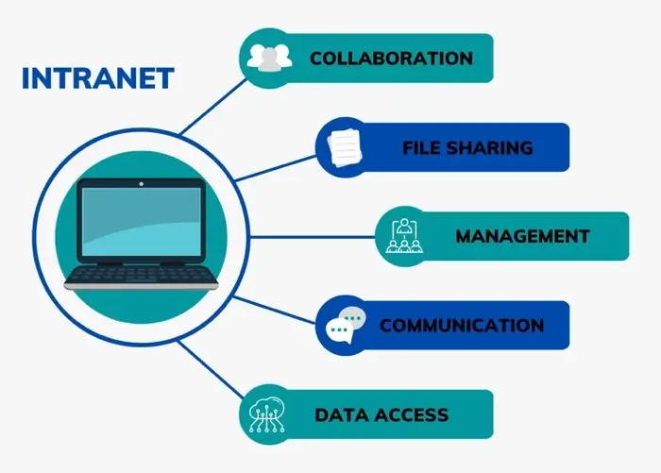
Intranet
Private network contained within a company
Used to securely share company information among employees.

